Slide 1

Sauce & Spoon
Tablet Rollout
Impact Report

Slide 2
Executive Summary
In order to boost customer satisfaction and retention, we want to offer a new menu tablet option that allows consumers to order using a tablet and then pay and check out using our platform. Let's now discuss the project's accomplishments.
The purpose of the Tablet rollout was to raise customer satisfaction and their overall dining experience. We held trials and then rolled out the tablet at multiple locations. After the pilot, customer satisfaction was at 72%.Once we implemented improvements based on feedback, customer satisfaction increased to 86%.
During the pilot's introduction, the biggest complaint from our consumers was that it took a while for our cash-paying clients to check out and that some of their items took longer than planned to be fulfilled. We've already taken mitigation measures.
We learnt :
We learned that customers had issues with the software, but the necessary upgrades were made.
We also learned after implementation of the tablets that we increased the average daily guest count by 10%. As well as decreasing wait time by 30 minutes.
The next thing :
We will add new features like reservations, social media integration, videos, etc. and develop a new project plan for installing new locations.
We will determine new locations to install the tablets.

Slide 3
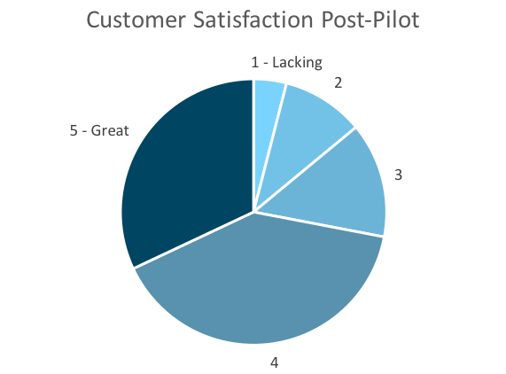
Customer Satisfaction: Pilot
Q. On a scale of 1-5, please rate your experience with the tablet overall.
This pie chart illustrates the results from the post-pilot survey.
72% of respondents indicated a customer satisfaction score of 4 or 5.
Notes:
First pie chart: Results from the post-pilot survey
Second pie chart: Results from the post-launch survey, after making changes
Satisfaction has gone up from 72% (4 and 5 rating) to 86% (4 and 5 rating)
Post-pilot data:
1 - Lacking 2 4%
2 5 10%
3 7 14%
4 20 40%
5 - Great 16 32%
Post-launch data:
1 - Lacking 1 2%
2 2 4%
3 4 8%
4 22 44%
5 - Great 21 42%

Slide 4
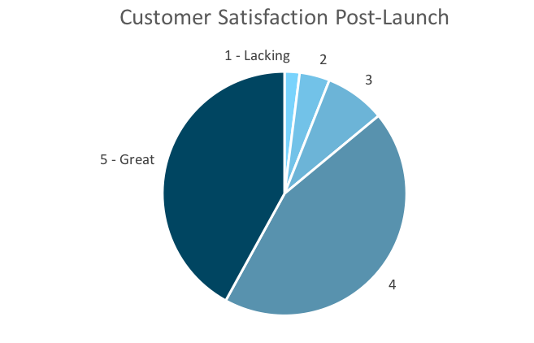
Customer Satisfaction: Launch
Q. On a scale of 1-5, please rate your experience with the tablet overall.
This pie chart illustrates the results from the post-launch survey.
86% of respondents indicated a customer satisfaction score of 4 or 5. This is a 14% increase.
Notes:
First pie chart: Results from the post-pilot survey
Second pie chart: Results from the post-launch survey, after making changes
Satisfaction has gone up from 72% (4 and 5 rating) to 86% (4 and 5 rating)
Post-pilot data:
1 - Lacking 2 4%
2 5 10%
3 7 14%
4 20 40%
5 - Great 16 32%
Post-launch data:
1 - Lacking 1 2%
2 2 4%
3 4 8%
4 22 44%
5 - Great 21 42%

Slide 5
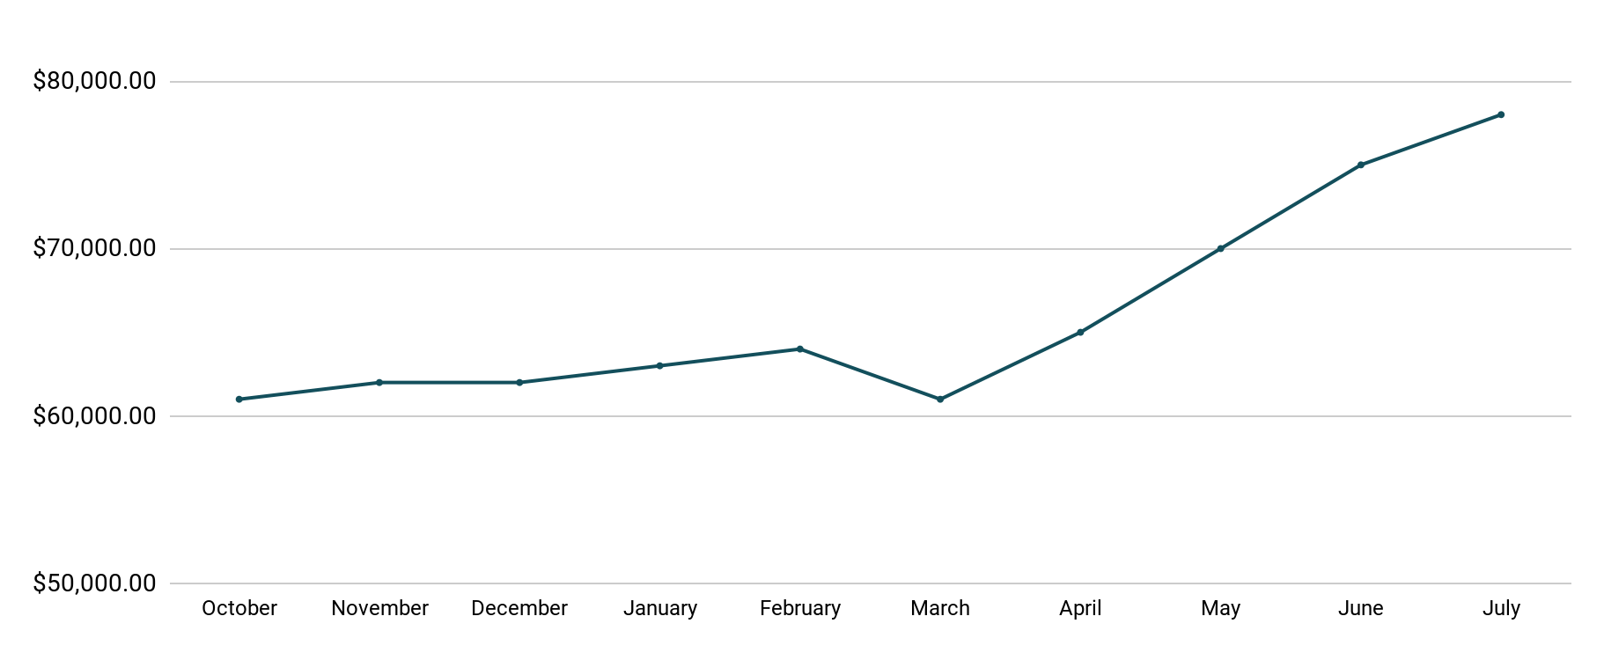
Revenue
Tablet Launch April 23
This is a chart of Sauce & Spoon revenue, showing that after tablet implementation, revenue increased.
July revenue was up to 20% over April’s monthly revenue.
Notes:
This is a chart of Sauce & Spoon revenue, showing that after tablet implementation, revenue increased. December revenue was up to 20% over September’s monthly revenue.
Sales data:
October
$61,000.00
November
$62,000.00
December
$62,000.00
January
$63,000.00
February
$64,000.00
March
$61,000.00
April
$65,000.00
May
$70,000.00
June
$75,000.00
July
$78,000.00

Slide 6
What Worked: Key Accomplishments
Decreased table turn time
Implementation of the tablets increased the average daily guest count by 10%.
Tablets also decreased wait time by 30 minutes.
Decreased food waste
Tablets identified who was receiving an incorrect order.
Kitchen staff has taken the initiative to correct orders and decrease food waste by 50%.
Increased customer satisfaction
After the pilot, customer satisfaction was at 72%.
Once we implemented improvements based on feedback, customer satisfaction increased to 86%.
Increased sales
Our monthly revenue has increased steadily since the tablet rollout, upwards of 20% since September/pre-rollout.
Tablets also helped boost revenue during the holiday season.

Slide 7
Next Steps: Looking Forward
Initiative | Action | Date
Implement tablets in more locations | Create new project plan for new location installation | Q2
Continue to track customer experience and satisfaction | Continue surveying/ gathering data through various means | Ongoing
Expand tablet features | Investigate new features like social media integration, reservations, videos, etc. | Q4

Slide 8
Appendix
Access all resources here.
Notes:
Insert link to your shared drive or a shared folder with all of the relevant project artifacts

